Slide 1

Surya Namaskar Yagna
Hindu Swayamsevak Sangh (USA)

Slide 2
Hindu Swayamsevak Sangh USA (HSS)
Hindu Swayamsevak Sangh is a US-based non-profit organization that aims to promote community spirit and ideals among Hindus residing in the United States. Our focus is to instill the values and virtues of Dharma in our next generation and contribute to the overall physical, intellectual, and spiritual development of local communities and to promote global unity and peace.

Slide 3
Health for Humanity Yogathon
Each year Hindus worldwide celebrate January 14th as Makar Sankranti – a day that marks the change of season as the Sun enters the sign of Capricorn or Makar. Makar Sankranti ushers in longer days; thus, the festivity symbolizes sunshine in life. To mark this occasion, HSS has organized the 16th annual "Health for Humanity" Yogathon for 16 days from January 15th to January 30th, 2022.
Hindu Swayamsevak Sangh USA (HSS) initiated this health awareness project in 2006 with the aim to create awareness about Yoga and its advantages in achieving a healthy body, mind, and spirit. Since its inception, participants from 43 states actively took part via various Yoga Centers, community organizations regardless of individual faiths and beliefs and collectively performed over 4 million Surya Namaskars. Community leaders and many elected officials across the nation have appreciated this initiative and given proclamations on this event.
Some of the other community and civic events HSS does are:
Guru Vandana (Teacher appreciation) where we appreciate and honor teachers in the traditional Hindu way of Guruvandana
Universal Oneness Day (Raksha Bandhan) where we tie rakhis to public officials, police & law enforcement officers, fire marshals and others thanking them for their service.
Sewa Diwali where we collect and donate food and other necessities to those who need them.

Slide 4
What is Surya Namaskar
‘Surya Namaskar’ is often referred to as the mother of all yogasans as it integrates simple Yoga postures into10-steps that along with an easy breathing technique, can provide immense health benefits to both the body and the mind. Performing Surya Namaskars results in numerous benefits to our physical body, mental health and emotional well-being.
This comprehensive routine stimulates almost every system in our body especially the cardiovascular, the digestive and the nervous systems and normalizes the activity of the endocrinal glands. It is extremely beneficial for our joints & ligaments and improves the flexibility and posture of our bodies.
A word of caution: People suffering from back conditions, high blood pressure, hernia and pregnant participants should seek proper advice before commencing Surya Namaskar. If you feel dizzy or uncomfortable, please stop the practice.

Slide 5
13 Mantras
 मित्राय नमः The Friend of All
 रवये नमः The Shining One
 सूर्याय नमः The One who induces Activity
 भानवे नमः The One who Illuminates
 खगाय नमः The One who moves quickly in the Sky
 पूष्णे नमः The Giver of Strength
 हिरण्यगर्भाय नमः The bright Centre of All Energy
 मरीचये नमः The Lord of Dawn
 आदित्याय नमः The Son of Aditi
 सवित्रे नमः The Benevolent One
 अर्काय नमः The One who is fit to be Praised
 भास्कराय नमः The One who leads to Enlightenment
 श्री सवितृसूर्यनारायणाय नमः The Surya (Sun)

Slide 6
Warm ups

Slide 7
Beginning Shloka
ॐ ध्यये सदा सवित्र मंडल मध्यवर्ती।
नारायण सरसिजसनसन्निविष्टः
केयूरवन मकरकुण्डलवान किरीटी।
हारी हिरण्मय वपुः धृतशंखचक्रः।
Meaning : Always worship the Sun [ Our Energy Source ] sitting at the centre of galaxy, on a lotus, wearing Keyur, Makarkundal and a Crown and holding a Conch and a Chakra and having a glittering golden body.

Slide 8
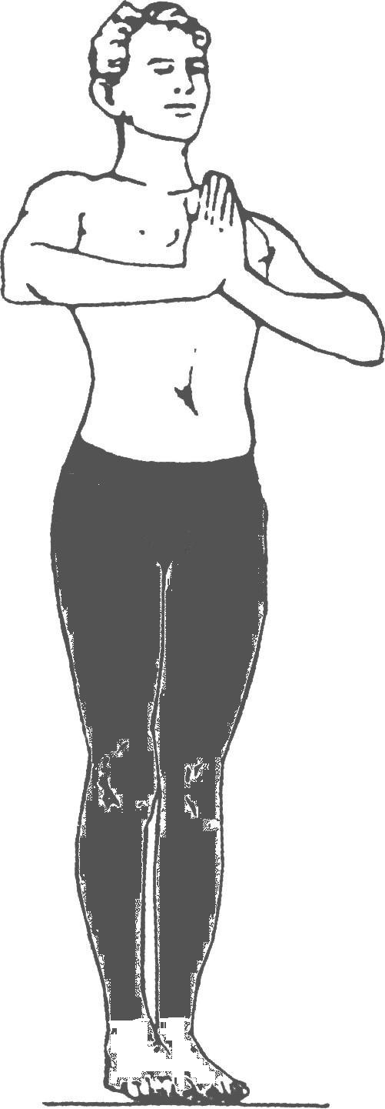
Surya Namaskar – Siddha stithi
Pranamasan/Namaskaarasan
Normal Breathing
Procedure : Fold hands together in Namaskar position. Forearms parallel to the ground. Feet together. Body weight evenly distributed over both feet. Calves, quads and hamstrings tightened. Abdominal muscles tightened. Breath normally
Benefits : This posture promotes balance and stimulates respiratory system, it cures diseases of the throat and vocal chords are enhanced.

Slide 9
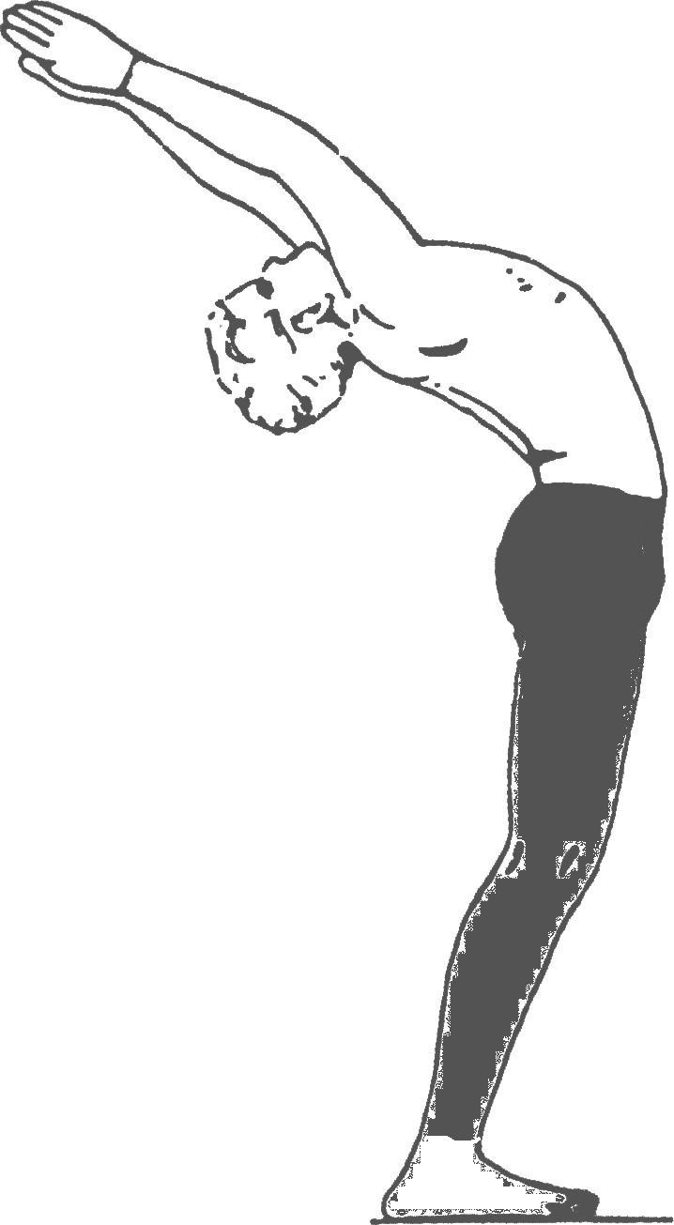
Surya Namaskar – Step 1
Urdhvasan/Ardha Chandrasan
Inhale
Procedure: Breathe in and with palms joined, push up and back forming an arch. Biceps should touch your ears. Maintain sight on wrists. Legs and Abdominal muscles remain tight.
Benefits : This posture promotes digestion, tones spine, arms and shoulders and builds flexibility in hips and back. Both the shoulders and the food pipe (Esophagus) get exercised and diseases related to them are corrected. Eyesight is also improved.

Slide 10
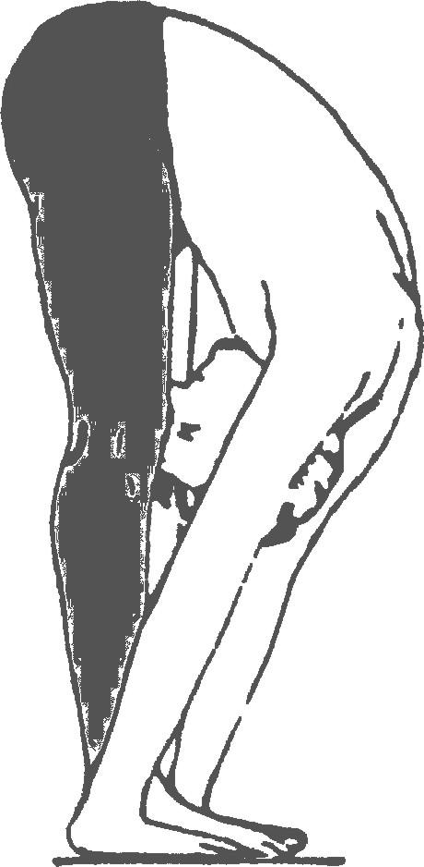
Surya Namaskar – Step 2
Uttanasan/Paadahastasan
Exhale
Procedure : Breathing out, from previous asana keep arms straight, keep back straight and bend from hips. Maintain sight on wrists. Try to put palms flat on ground. Try to touch forehead to knees. Do not bend the knees.
Benefits : Disorders of the belly and digestive system are corrected. The chest and hands become stronger. Spine is toned and diseases of the feet and fingers are also corrected.

Slide 11
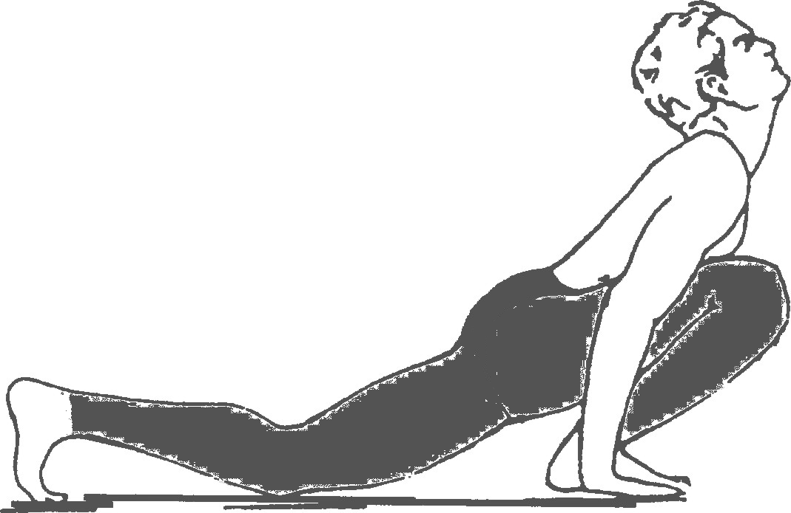
Surya Namaskar – Step 3
Eka Pada Prasaranasan/ Ashwasanchalanasan
Inhale
Procedure : From previous asana thrust your left leg back. Keep other foot in line with hands. Try to arch and look up while breathing in.
Benefits : The posture stretches the small intestine and the seminal vesicles, correcting constipation and diseases of the liver. This posture also strengthens hands, wrist, abdomen and thigh muscles, exercises the spine and prevents back problems.

Slide 12
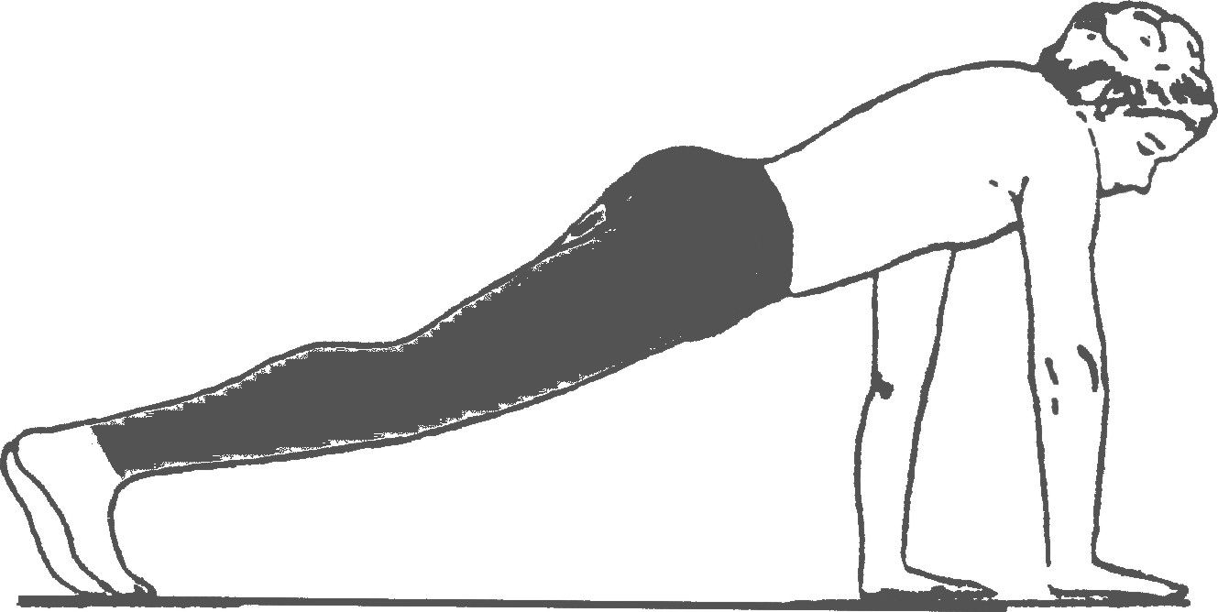
Surya Namaskar – Step 4
Chaturang Dandasan
Exhale
Procedure : While exhaling, from previous asana lift knee off the ground. Thrust second leg backwards. Keep feet together and knees together. Maintain a straight & inclined line throughout the body. Keep sight on ground at right angle.
Benefits : This posture stimulates blood circulation, strengthens heart, relieves neck and shoulder tension, improves brain function and reduces anxiety, depression and abdominal disorders.

Slide 13
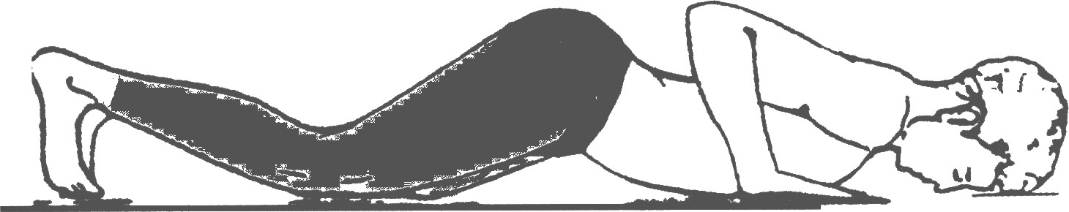
Surya Namaskar – Step 5
Sashtang Pranipatasan
Hold Breath
Procedure : Lower entire body to the ground slowly. Only forehead, chest, knees and toes touch ground. Keep hands and elbows close to the body. Keep feet together and knees together. Hold your breath.
Benefits : This posture strengthens leg and arm muscles and increases flexibility in neck and shoulders

Slide 14
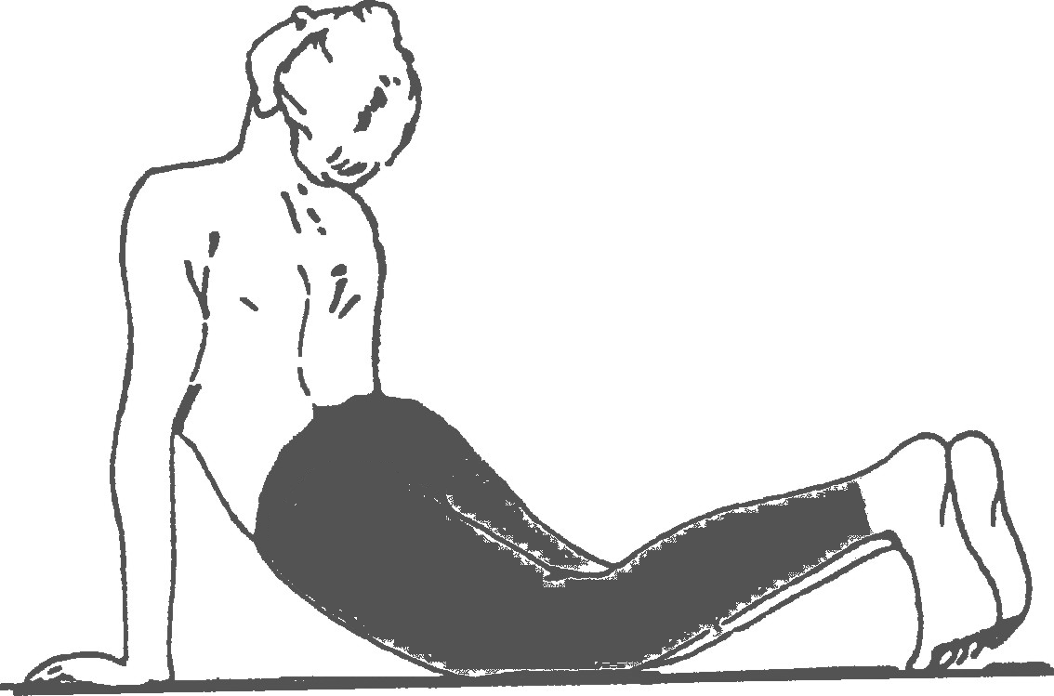
Surya Namaskar – Step 6
Urdhvamukh Shwanasan/Bhujangasan
Inhale
Procedure : From previous asana, while inhaling push body forwards and upwards. Keep feet together and knees together. Tighten forearms, biceps and triceps. Tighten abdominal muscles. Arch back and look upwards.
Benefits : Tones up the body and the back muscles and improves eyesight. Corrects disorders related to the reproductive system, corrects the irregularities in female menstrual cycles. Blood circulation is also improved. This posture stimulates circulation to abdominal organs, tones the digestive tract, increases lung capacity and relieves asthma

Slide 15
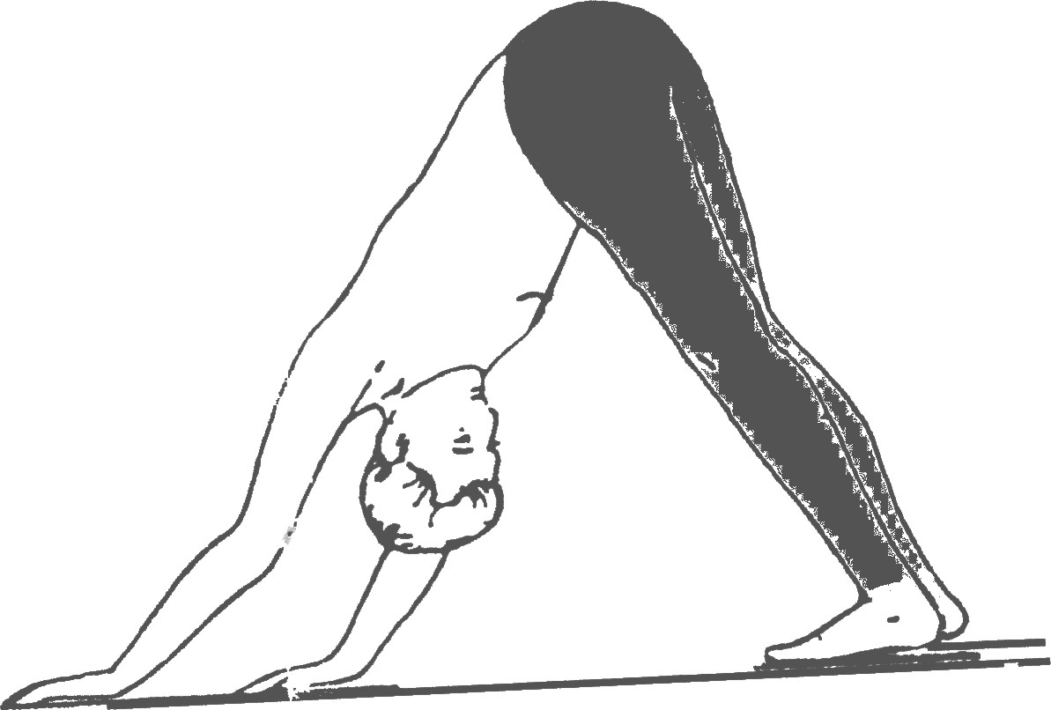
Surya Namaskar – Step 7
Adhomukh Shwanasan/Parvatasan
Exhale
Procedure : Raise your hips high with feet and palms flat on the floor while your head faces your navel. Exhale while doing this posture. Create the “mountain” shape. Keep feet together and knees together. Tuck head in between arms. Push chin towards the chest.
Benefits : By performing this posture, one gets relief from pains associated with arms, legs and the knees. Bulging waist is trimmed and it is good to correct abdominal disorders.

Slide 16
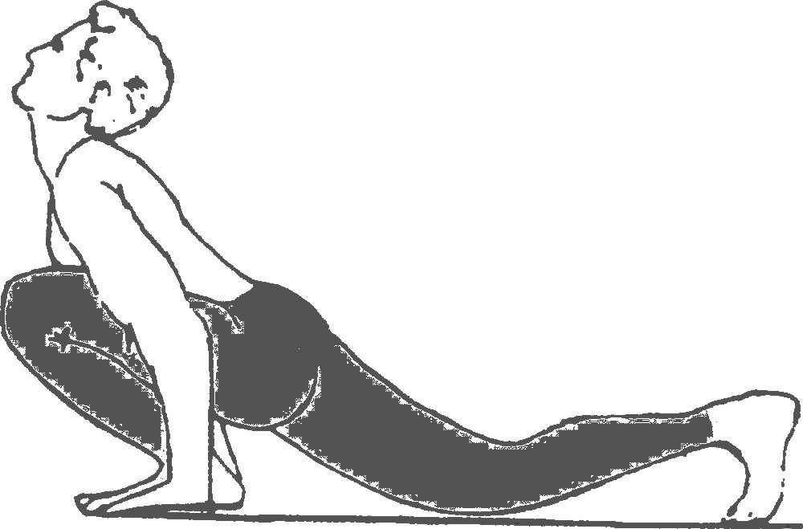
Surya Namaskar – Step 8
Eka Pada Prasaranasan/ Ashwasanchalanasan
Inhale
Procedure : From previous asana thrust the same leg as step 3 forward. Keep forward foot in line with hands. Try to arch your back and look upwards.
Benefits : The posture stretches the small intestine and the seminal vesicles, correcting constipation and diseases of the liver. This posture also strengthens hands, wrist, abdomen and thigh muscles, exercises the spine and prevents back problems.

Slide 17
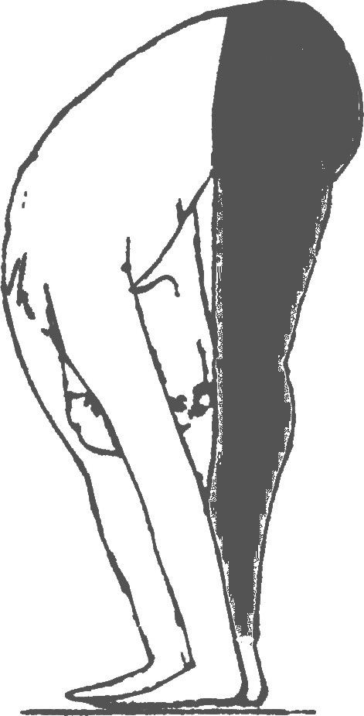
Surya Namaskar – Step 9
Uttanasan/Paadahastasan
Exhale
Procedure : From previous asana keep palms flat fixed on ground. Bring right foot forward in original position. Keep legs and arms straight. Try to touch forehead to knees while exhaling. Do not bend the knees.
Benefits : Disorders of the belly and digestive system are corrected. The chest and hands become stronger. Spine is toned and diseases of the feet and fingers are also corrected.

Slide 18
Surya Namaskar – Step 10
Pranamasan/Namaskaarasan
Normal Breathing
Procedure : Fold hands together in Namaskar position. Forearms parallel to the ground. Feet together. Body weight evenly distributed over both feet. Calves, quads and hamstrings tightened. Abdominal muscles tightened. Breath normally
Benefits : This posture promotes balance and stimulates respiratory system, it cures diseases of the throat and vocal chords are enhanced.

Slide 19
Ending Shloka
आदित्यस्य नमस्कारान् ये कुर्वन्ति दिने दिने ।
आयुः प्रज्ञां बलं वीर्यं तेजस्तेषां च जायते ॥
Meaning : Those who regularly perform Suryanamaskaras will attain a healthy and long life. They will become strong, knowledgeable and valorous. They will posses a bright and endearing personality.

Slide 20
Concluding remanks
Upcoming Event – In April of this year, HSS is organizing a Hindu Dharma Exhibition. This exhibition will showcase the scientific contributions, philosophy, religious texts, cuisine, yoga, architectural contributions, art, fabrics and other contributions by Hindus to the world. Please attend this event and make it a success.

